Slide 1

CodePrep: The All-in-One Career Prep Platform
CodePrep is a comprehensive learning platform designed to equip students with the essential skills for tech careers. It combines coding practice, AI-powered mock interviews, progress tracking, and peer collaboration into one unified system, helping universities prepare their students for the demands of the modern tech industry.

Slide 2
The Core Challenge: All-in-One Career Prep
Structured Coding Problems
AI-Simulated Interviews
With live code execution for practical experience.
Technical and behavioral interviews with AI guidance.
Detailed Progress Tracking
Real-Time Collaboration
Analytics to monitor student development and readiness.
Enabling peer programming and study groups.
Our platform addresses the need for a single, integrated system that streamlines career preparation for tech students.

Slide 3




Target Audience: Empowering Key Stakeholders
Students
Professors
Practice coding and interview skills in one comprehensive platform.
Assign problems, track student development, and identify areas for improvement.
Career Services
Universities
Monitor student job readiness and provide data-driven support.
Support students with data-driven insights to enhance career outcomes.

Slide 4





Core Features: Smart Coding Environment
In-Browser Editor
Syntax highlighting for a seamless coding experience.
Isolated Execution
Run code safely in secure Docker containers.
Multi-Language Support
Python, Java, JavaScript, C++ supported.
Solution Storage
All solutions saved for future review.

Slide 5

Core Features: AI Interview Simulator
1
Technical Interviews
Real coding questions with AI guidance.
2
Behavioral Interviews
AI analyzes communication skills and responses.
3
Instant Feedback
Suggestions like "Explain your logic more clearly."
4
Progress Tracking
Interview readiness score to monitor improvement.

Slide 6

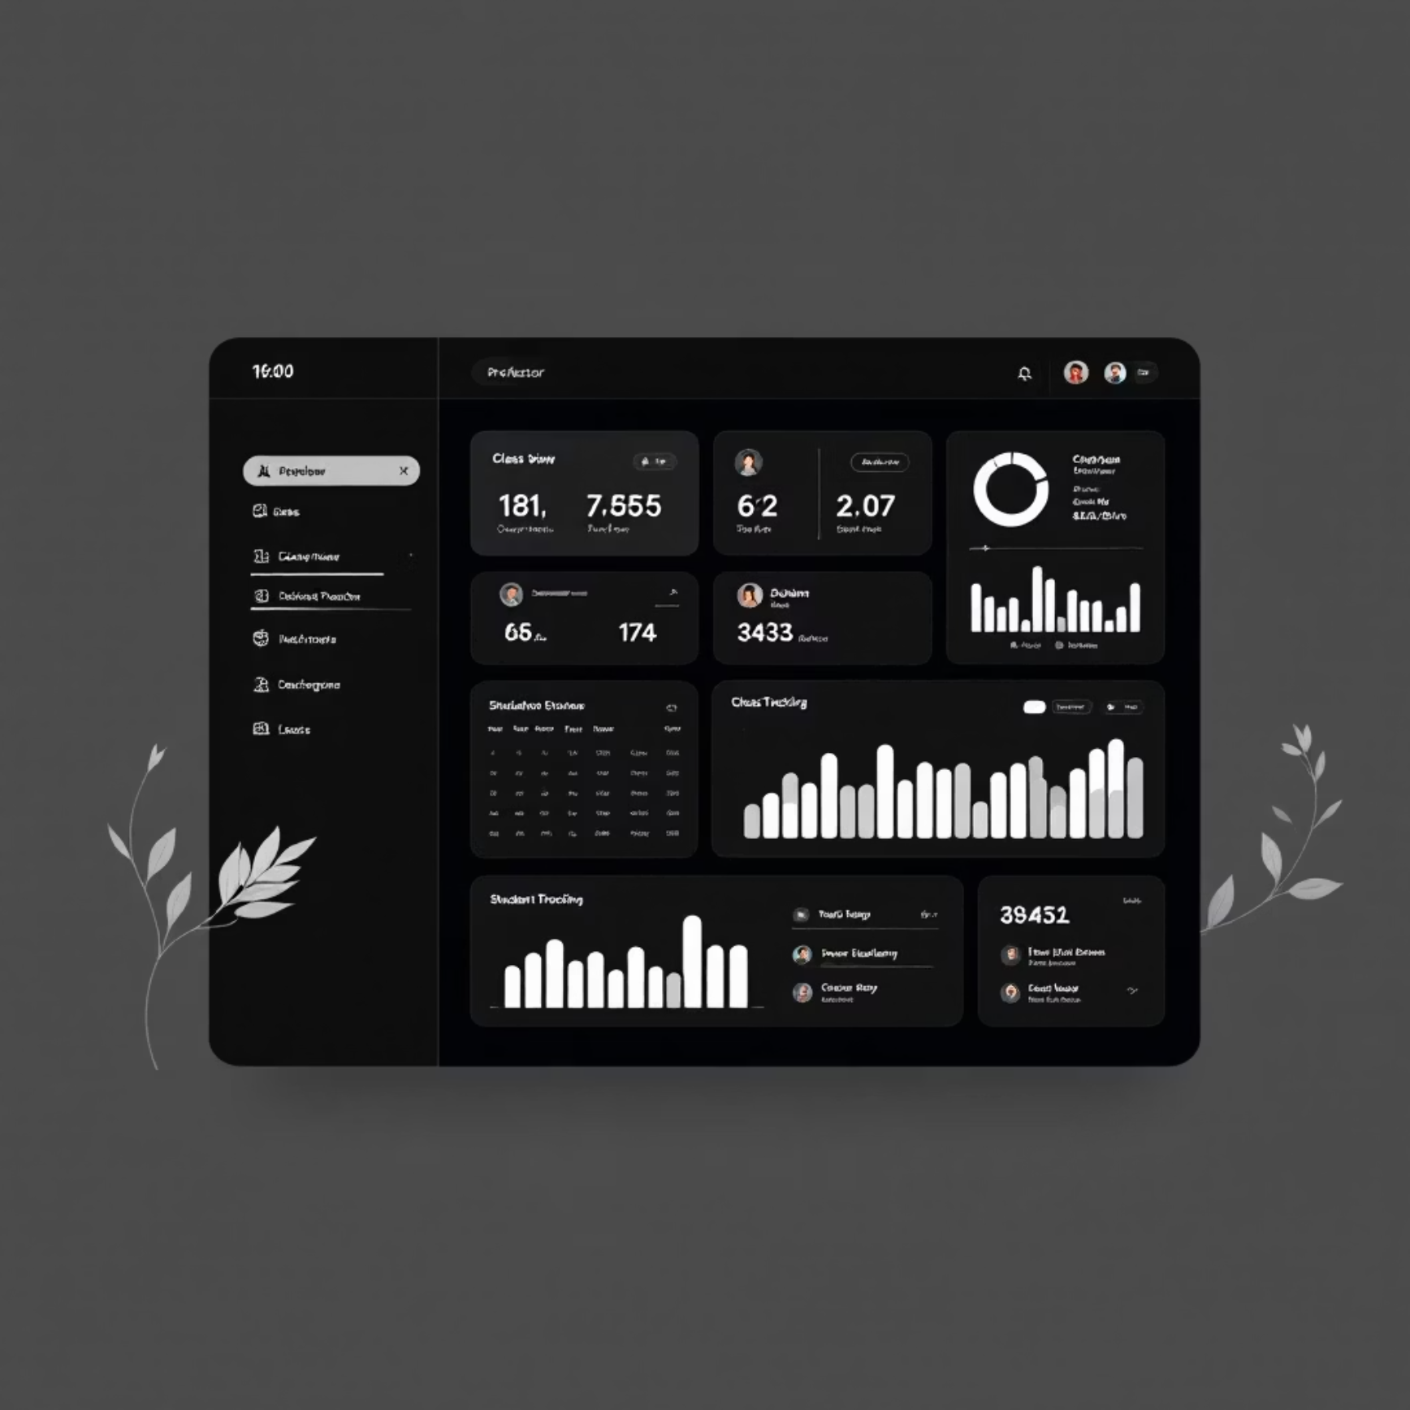
Core Features: Performance Analytics
Student View
Professor Dashboard
Personal progress charts and identification of weak areas.
Class overview and detailed individual student tracking.
UniCode provides comprehensive analytics tailored to different user needs, offering actionable insights for students, professors, and the university administration.

Slide 7

Core Features to be implemented soon : Peer Collaboration
Live Pair Programming
Study Groups
Code Sharing
Code together in real-time with classmates.
Practice interviews and algorithms with peers.
Get help and feedback on difficult problems.

Slide 8

Student Experience: A Seamless Journey
01
Login & Assignments
Sees 10 new problems assigned by professor.
02
Problem Solving
Solves "Two Sum" problem, gets instant feedback and score.
03
Mock Interview
Takes AI mock interview, receives improvement suggestions.
04
Collaborate
Joins study group, collaborates on algorithms with classmates.

Slide 9

Professor Experience: Guiding Student Success
01
Assign Problem Sets
Assigns weekly problem sets to Data Structures class.
02
Review Performance
Reviews class performance, notices 60% struggle with recursion.
03
Targeted Practice
Schedules extra recursion practice session.
04
Track Readiness
Tracks student interview readiness before placement season.

Slide 10

Tech Stack
Tech Requirements
Frontend: React.js with Monaco Editor
Backend: Node.js with secure Docker containers
AI: OpenAI GPT for interviews
Collaboration: Socket.io for real-time features
Database: PostgreSQL for data

